Slide 1
CCP: Crown Fire Initiation and Crown Stratum Ignition Events
Crown fire initiation is problematic in multi-layered stands
When understory conifers (or other species) torch off, ignition of upper canopy cohorts is facilitated
E.g. Van Wagner (1993; discussing Kenshoe Lake):
“The mature stand, however, with its distinct black spruce understory, presented a problem. Because the spruce occupied the space below the mature pine crowns, in which crowning began. It contributed 42% of the prefire foliage weight and, because very few fires in the mature stand penetrated into the pine canopy, most of the foliage that was actually consumed. However, the theory of Van Wagner (1977) assumes a single uniform crown layer, constant throughout its depth in all properties . For mature pine, a compromise was therefore arranged. First, because the pine canopy played no part in the onset of crowning, ISO (the criterion for it) was based on the spruce understory layer alone. Second, it was assumed that fully active crown fire must depend mainly on the pine canopy above; the spruce understory would be consumed but would lose its direct control over the fire’s behavior. “ … “Also needed for ISO were values for CBH. The estimated value of CBH in the immature stand was 4 m and for the mature pines themselves, 12 m. But the black spruce understory, on which the onset of crowning depended in the latter, extended irregularly from near the ground to the overhead pine canopy. Based on advice from B.J. Stocks (personal communication), an effective CBH of 2 m was therefore assigned to it. “

Slide 2
CCP: Crown Fire Initiation and Crowning Events
Current approach – for most (single-stratum overstory) conifer stands:
Standard empirical CFI for most (single-layer) stands:
P(CFI) ~ ws, mc, SFC, LCBH
Current model has 108 fires (note approach for Sharpsand):
Proposed solution: Define crown stratum ignition events as flaming transition between crown fuel strata:
Surface to understory conifer, UC to overstory, etc.
Biggest uncertainties are lower strata FC (e.g. SFC)
Possible (simple) solution: mean of SFC and lower stratum CFC; for modelling, this requires estimate of CFC
Or just use lower stratum FC
Changing wind speed is also a problem, but not addressed by CCP

Slide 3
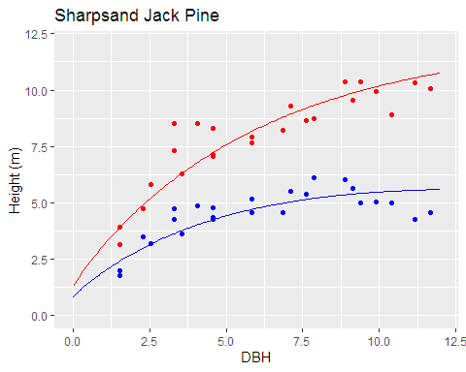
Crown Fire Initiation – Simple stand: Sharpsand Creek, ON (C-4/C-3)
Relatively simple structure – single canopy layer
Complicated by dense ladder fuels: fine dead standing trees, equal in number to live stems
Sharma and Parton (2007) mixed-effects model of
Height-DBH, with density, BA; with site as random
effect

Slide 4
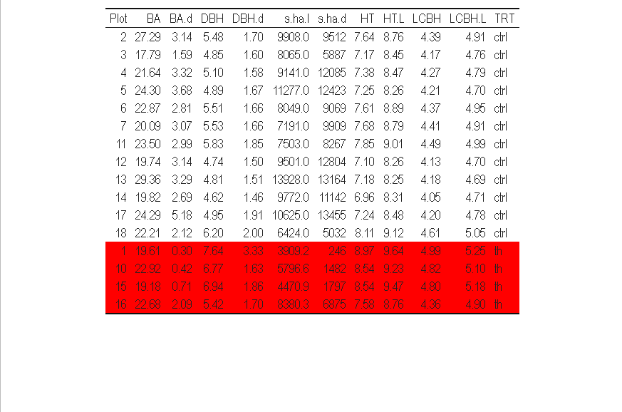
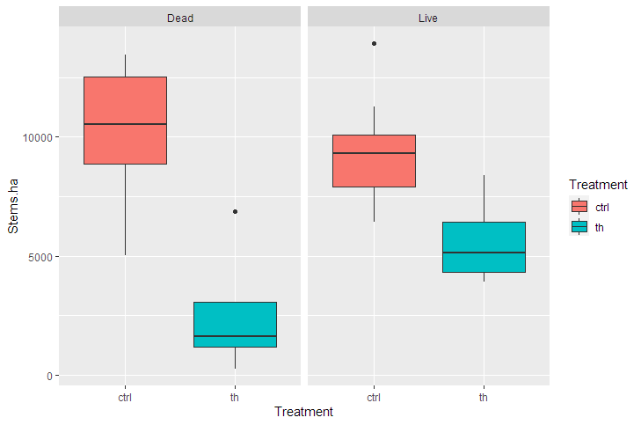
Sharpsand Creek:
Unthinned (control/C-4) vs thinned stands:
> plots %>% left_join(plots2, by=c('Plot', 'TRT')) %>% arrange(TRT) %>%
select(-TRT) %>% round(2) %>%
left_join(select(plots2, Plot, TRT), by='Plot') %>%
kbl() %>%
kable_classic(full_width=F) %>%
row_spec(13:16, background='red')
> plots2 %>% filter(TRT=='ctrl') %>% summarize(mean(LCBH))
4.29
Thinned stands have lower s/ha (live & dead; P< 0.05 for both); estimated heights and LCBH based on biomass tree relationship may not be reliable
(except Plot 16, seems unthinned)

Slide 5





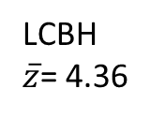
Sharpsand Creek Canopy Fuels: (unthinned; C-4 in FBPS)
Live s/ha: 10,229 (~6400 – 14,000)
Dead s/ha: 9,282 (5000 – 13,000)
Snag total: 52.4% of density
LCBH
$\overline{z}$= 4.36
Dead snags
Mean(ht)= 3.5 m
Treat as ‘elevated surface fuels’?
Mean snag centroid height = 1.73 m
Mean snag dbh=1.68 cm

Slide 6
Sharpsand Creek Canopy Fuels: (unthinned; C-4 in FBPS)
Live s/ha: 10,229 (~6400 – 14,000)
Dead s/ha: 9,282 (5000 – 13,000)
Snag total: 52.4% of density
LCBH
$\overline{z}$= 4.36

Slide 7
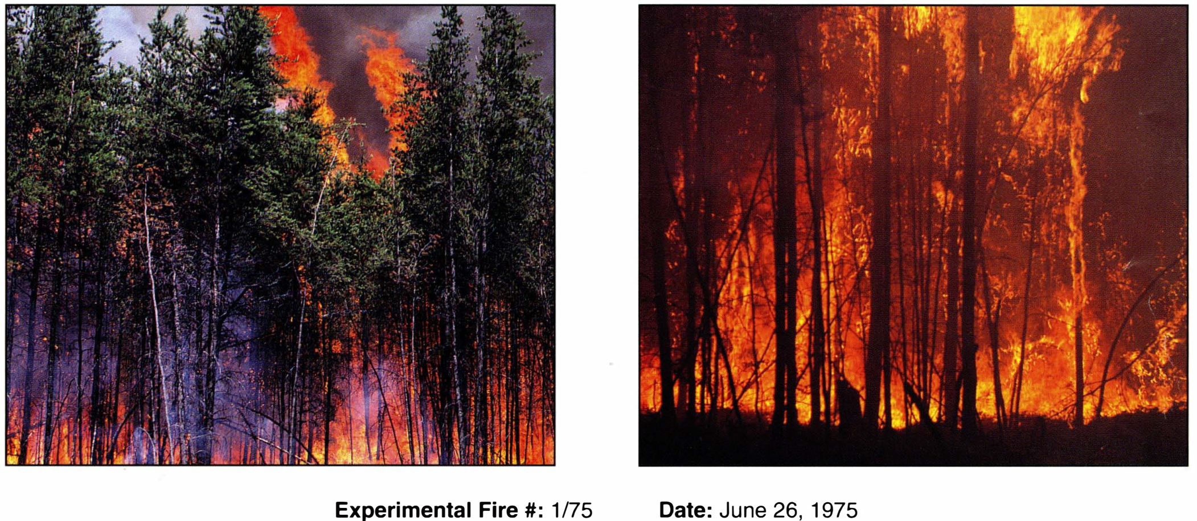
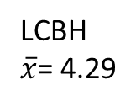
Sharpsand Creek (‘intermittent crown fire’; photo Stocks and Hartley 1995):
LCBH
$\overline{x}$= 4.29
Q: How to account for elevated surface fuels from standing dead (ie, snags)?

Slide 8
Concept:
‘Scale down’ (vert.) /
‘Scale up’ (fuel con.)
Snag FC as if they were
surface fuels
LCBH
$\overline{z}$= 4.36
Use VW77 CFI model (Thomas ’63) to scale elevated fuels to ‘near’ ground level

Slide 9
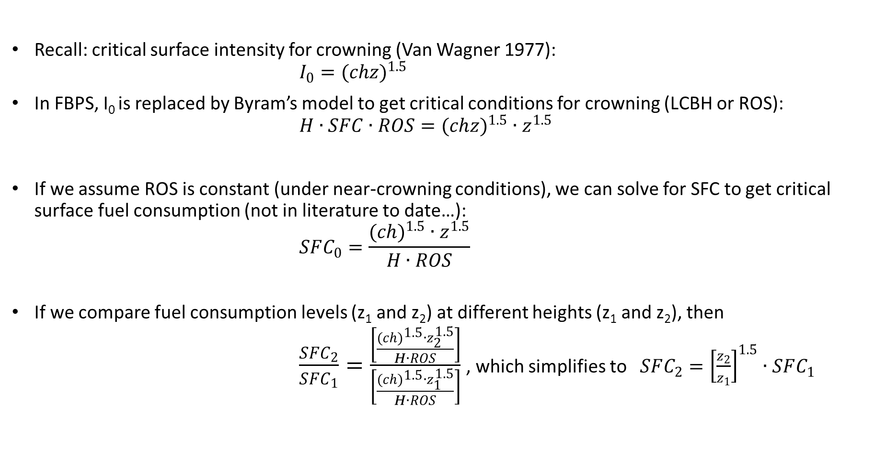
Critical SFC from CEVW1977 & Byram 1959
Recall: critical surface intensity for crowning (Van Wagner 1977):
$$I_{0}=(chz)^{1.5}$$
In FBPS, I₀ is replaced by Byram’s model to get critical conditions for crowning (LCBH or ROS):
$$H∙SFC∙ROS=(ch{z)}^{1.5}∙z^{1.5}$$
If we assume ROS is constant (under near-crowning conditions), we can solve for SFC to get critical surface fuel consumption (not in literature to date…):
$$SFC_{0}=\frac{(ch)^{1.5}∙z^{1.5}}{H∙ROS}$$
If we compare fuel consumption levels (z₁ and z₂) at different heights (z₁ and z₂), then
$\frac{SFC_{2}}{SFC_{1}}=\frac{\left[\frac{(ch)^{1.5}∙z_{2}^{1.5}}{H∙ROS}\right]}{\left[\frac{(ch)^{1.5}∙z_{1}^{1.5}}{H∙ROS}\right]}$ , which simplifies to $SFC_{2}={\left[\frac{z_{2}}{z_{1}}\right]}^{1.5}∙SFC_{1}$

Slide 10
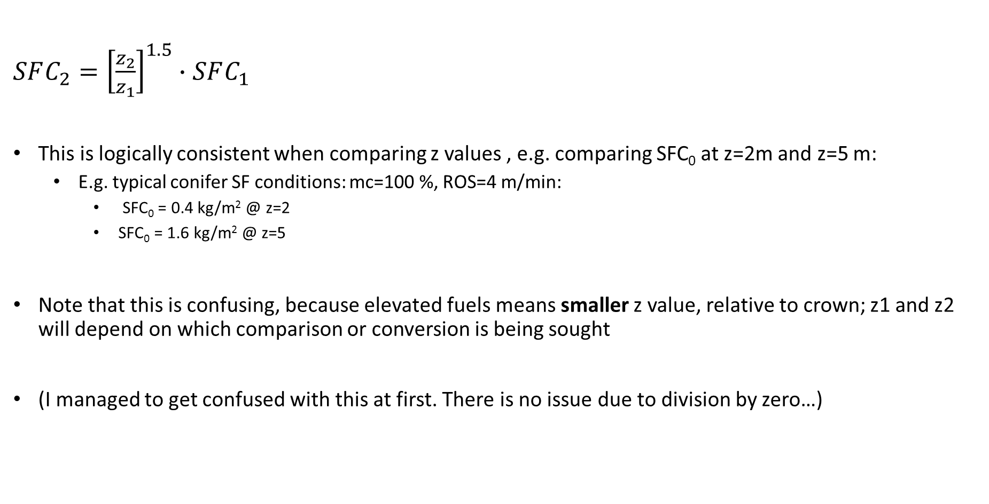
Critical SFC from CEVW1977 & Byram 1959
$SFC_{2}={\left[\frac{z_{2}}{z_{1}}\right]}^{1.5}∙SFC_{1}$
This is logically consistent when comparing z values , e.g. comparing SFC₀ at z=2m and z=5 m:
E.g. typical conifer SF conditions: mc=100 %, ROS=4 m/min:
SFC₀ = 0.4 kg/m² @ z=2
SFC₀ = 1.6 kg/m² @ z=5
Note that this is confusing, because elevated fuels means smaller z value, relative to crown; z1 and z2 will depend on which comparison or conversion is being sought
(I managed to get confused with this at first. There is no issue due to division by zero…)

Slide 11

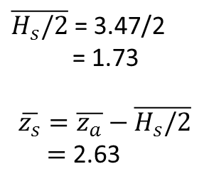
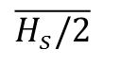
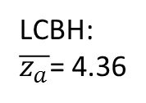
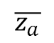

$\overline{H_{s}/2}$ = 3.47/2
= 1.73
$$\overline{z_{s}}=\overline{z_{a}}−\overline{H_{s}/2}$$
$=$2.63
LCBH:
$\overline{z_{a}}$= 4.36
$\overline{H_{s}}$
$$\overline{z_{a}}$$
$$\overline{z_{s}}=\overline{z_{a}}−\overline{H_{s}/2}$$
$\overline{H_{s}/2}$

Slide 12
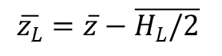
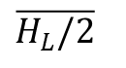
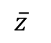

$\overline{H_{L}}$
$$\overline{z}$$
$$\overline{z_{L}}=\overline{z}−\overline{H_{L}/2}$$
$\overline{H_{L}/2}$
Notes:
Orig. CCP figure

Slide 13
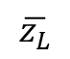
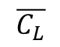
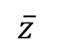
$$\overline{z_{L}}$$
$$\overline{z}$$
$$\overline{C_{L}}$$
Notes:
New LF paper figure

Slide 14
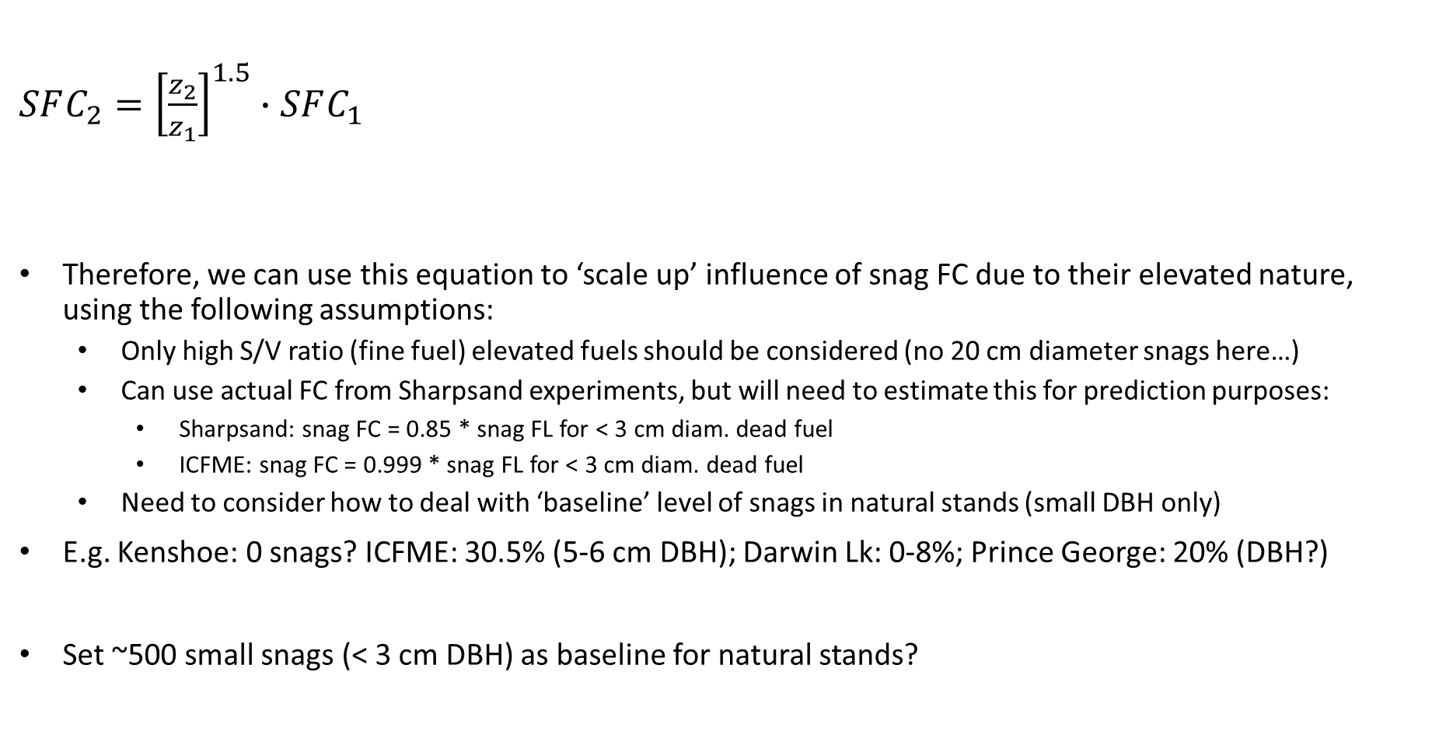
Critical SFC from CEVW1977 & Byram 1959
$SFC_{2}={\left[\frac{z_{2}}{z_{1}}\right]}^{1.5}∙SFC_{1}$
Therefore, we can use this equation to ‘scale up’ influence of snag FC due to their elevated nature, using the following assumptions:
Only high S/V ratio (fine fuel) elevated fuels should be considered (no 20 cm diameter snags here…)
Can use actual FC from Sharpsand experiments, but will need to estimate this for prediction purposes:
Sharpsand: snag FC = 0.85 * snag FL for < 3 cm diam. dead fuel
ICFME: snag FC = 0.999 * snag FL for < 3 cm diam. dead fuel
Need to consider how to deal with ‘baseline’ level of snags in natural stands (small DBH only)
E.g. Kenshoe: 0 snags? ICFME: 30.5% (5-6 cm DBH); Darwin Lk: 0-8%; Prince George: 20% (DBH?)
Set ~500 small snags (< 3 cm DBH) as baseline for natural stands?

Slide 15
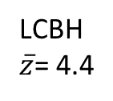
Sharpsand Creek Canopy Fuels:
(thinned; C-3 in FBPS)
Live s/ha: 5,639
Dead s/ha: 2,600
LCBH
$\overline{z}$= 4.4

Slide 16
Sharpsand Creek Canopy Fuel Measures:
LCBH
$\overline{x}$= 4.29
* Estimate (not measured)

Slide 17
Kenshoe Lake
Jack pine overstory (2057 s/ha; 31.2 m^2/ha BA)
Black spruce understory (1093 s/ha; 4.0 m^2/ha BA)
Reported Jack pine LCBH: 11.6 m
Mean black spruce height not reported (range: 1-13 m)
What does crown fire refer to?
-crowning in parts of the black spruce (CFB): Stocks (1989), VW 1993; with LCBH of 2 m (VW 1993, Cruz 1999, Cruz et al. 2003)
-Crowning in the jack pine (STX-3); LCBH of 8 m
Can we consider separate crowning events??
-crowning in ‘understory’ spruce → surface fire
-crowning in ‘mid-story’ spruce → crowning event, based on FSG (spruce LCBH-understory or fuelbed height)
-crowning in overstory pine → crowning event, based on FSG (pine LCBH-spruce height)
-Non-independent events, so stats will have to be interpreted carefully

Slide 18

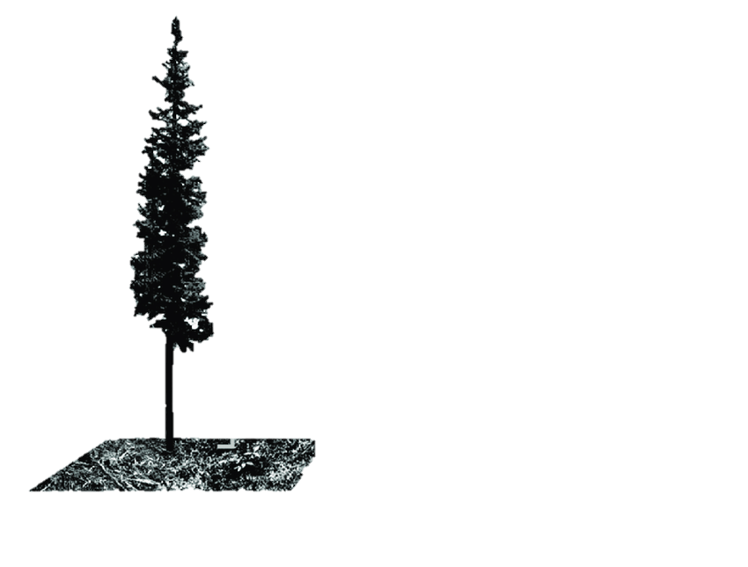
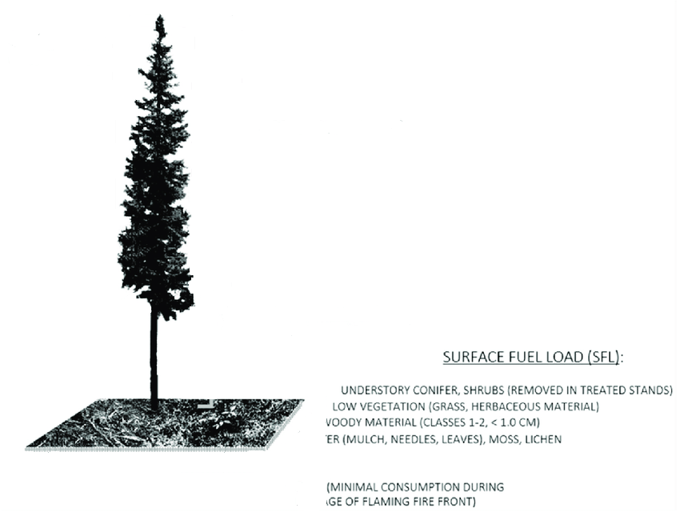


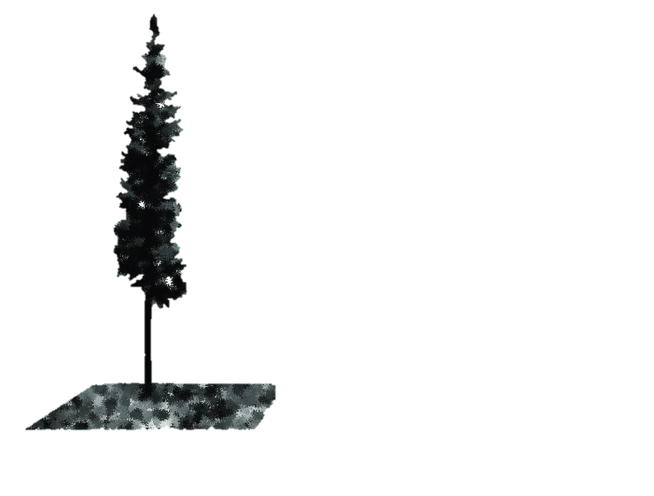


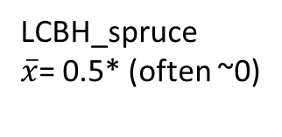
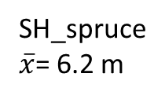
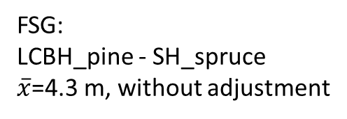
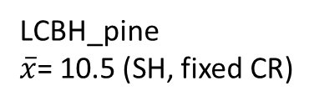
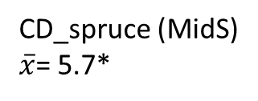
Kenshoe Lake Canopy Fuel
Measures:
LCBH_pine
$\overline{x}$= 10.5 (SH, fixed CR)
FSG:
LCBH_pine - SH_spruce
$\overline{x}$=4.3 m, without adjustment
SH_spruce
$\overline{x}$= 6.2 m
CD_spruce (MidS)
$\overline{x}$= 5.7*
LCBH_spruce
$\overline{x}$= 0.5* (often ~0)
* Overall estimate (not measured)

Slide 19
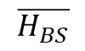
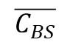
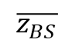
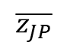
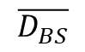

$$FSG=$$
$$z_{JP}−\left[z_{BS}+\frac{H_{BS}−z_{BS}}{2}\right]$$
$$\overline{z_{JP}}$$
$$\overline{H_{BS}}$$
$$\overline{C_{BS}}$$
$$\overline{D_{BS}}$$
$$\overline{z_{BS}}$$
Notes:
Figure 3:

Slide 20
$$\overline{z_{BS}}$$
Notes:
Figure 3:

Slide 21
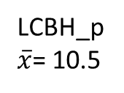
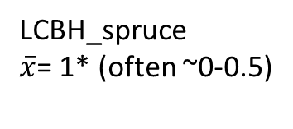
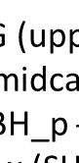
Kenshoe Lake Canopy Fuel
Measures:
LCBH_p
$\overline{x}$= 10.5
FSG (upper LCBH to midpoint
of midcanopy conifer crown):
LCBH_p - SH_sp +
0.5 x (SH_sp – LCBH_sp)
$\overline{x}$=6.9 m, without adjustment
LCBH_spruce
$\overline{x}$= 1* (often ~0-0.5)
* Overall estimate (not measured)

Slide 22
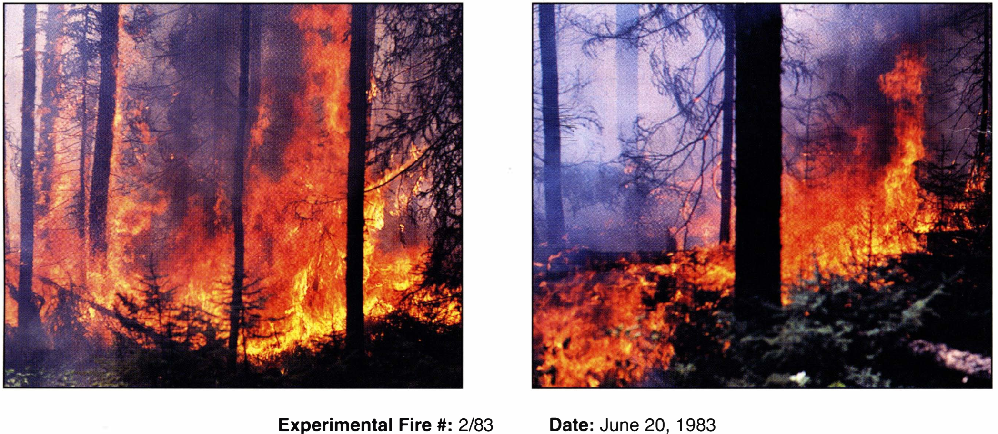
Kenshoe Lake –’vigorous surface fire’
LCBH
$\overline{x}$= 4.29

Slide 23
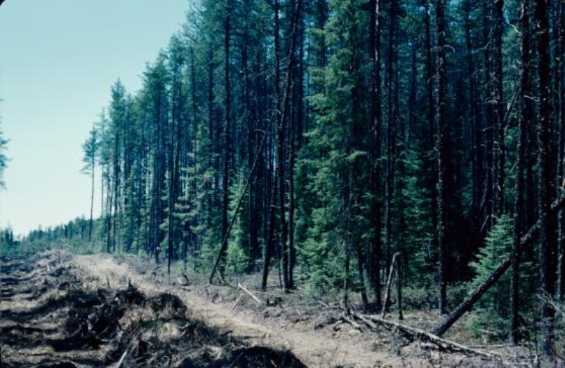
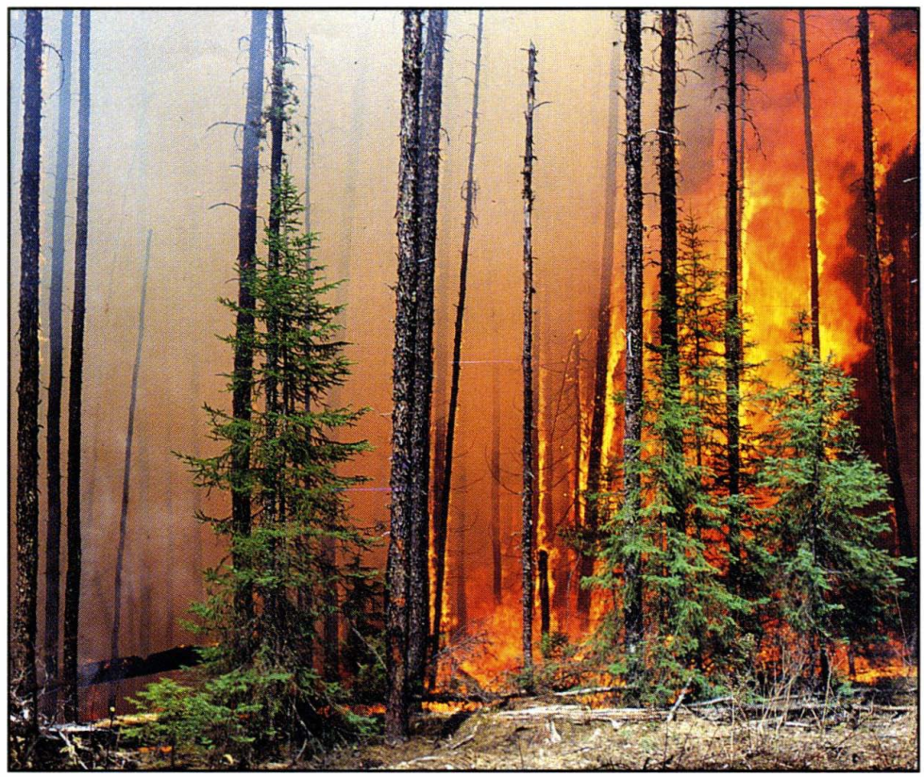
Kenshoe Lake fuels:
LCBH
$\overline{x}$= 4.29
* Estimate (not measured)

Slide 24

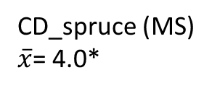
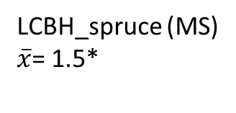
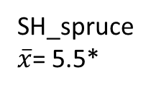
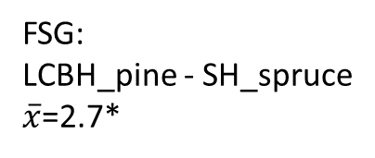
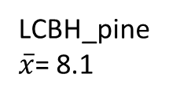
ICFME Canopy Fuel
Measures:
LCBH_pine
$\overline{x}$= 8.1
FSG:
LCBH_pine - SH_spruce
$\overline{x}$=2.7*
SH_spruce
$\overline{x}$= 5.5*
CD_spruce (MS)
$\overline{x}$= 4.0*
LCBH_spruce (MS)
$\overline{x}$= 1.5*
* Excluding plots 3 & 4 (no MS spruce)
US spruce

Slide 25
LCBH= 8.9 m
LCBH= 8.1 m
LCBH= 8.6 m
FSG=3.6m
1.9m
2.8 m
SH*1=5.3
SH*1=6.2
SH*1=5.8
Based on FSG = LCBH(JP) – (SH(BS)*1)
JP crown based on LCBH(JP) + LCD

Slide 26
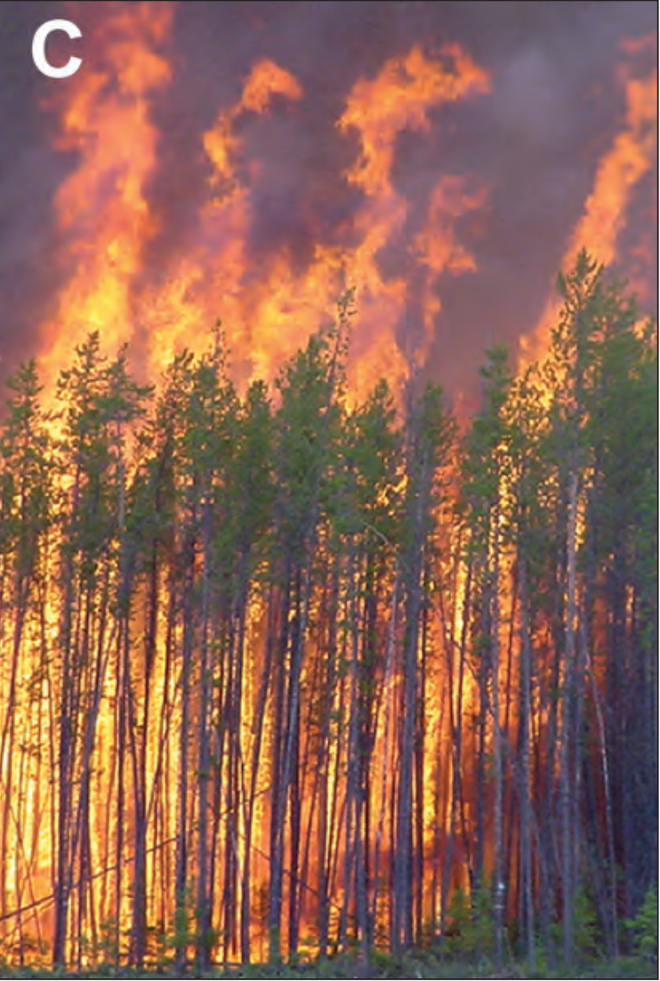
ICFME fire photo; from Alexander & Cruz 2016 (M. Cruz photo)
Plot 3?

